Slide 1

Cyber security chatbot
By: Kopano Leshope ST10459862
leshopeChatBotPrj

Slide 2

Classes
Lets discuss all the classes that are in this program…

Slide 3
Class 1:
NAME: Program Class(The main class)

Slide 4
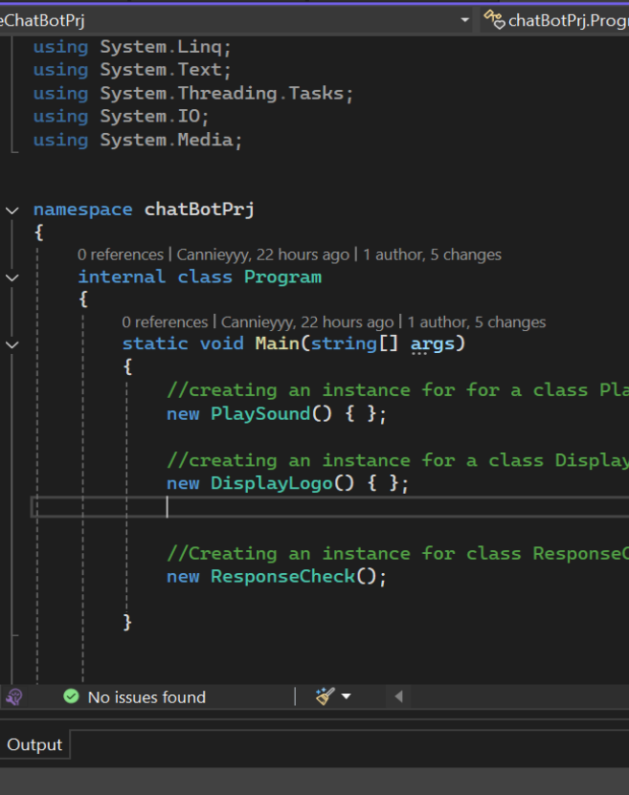
Program class
Where the program executes…
The program class only contains instances of other classes, these instances are invoked in the order of execution:
First we have the PlaySound class instance, that plays the voice greeting immediately after the program starts to run.
Secondly we have a DisplayLogo class instance that displays the logo after the voice greeting is complete
Lastly we have the ResponseCheck class instance, this is where the user interacts with the program.

Slide 5
Class 2:
NAME: PlaySound Class(class that plays the voice greeting)

Slide 6
PlaySound class
The code that allows the voice greeting to play
On this class we are playing a audio file on the program:
The class determines the correct file path dynamically.
It ensures the .wav file is located in the project's root folder not in the bin\debug .
It plays the sound synchronously so the program waits for the sound to finish before the program continues to play.
It handles potential errors gracefully using a try-catch block.

Slide 7
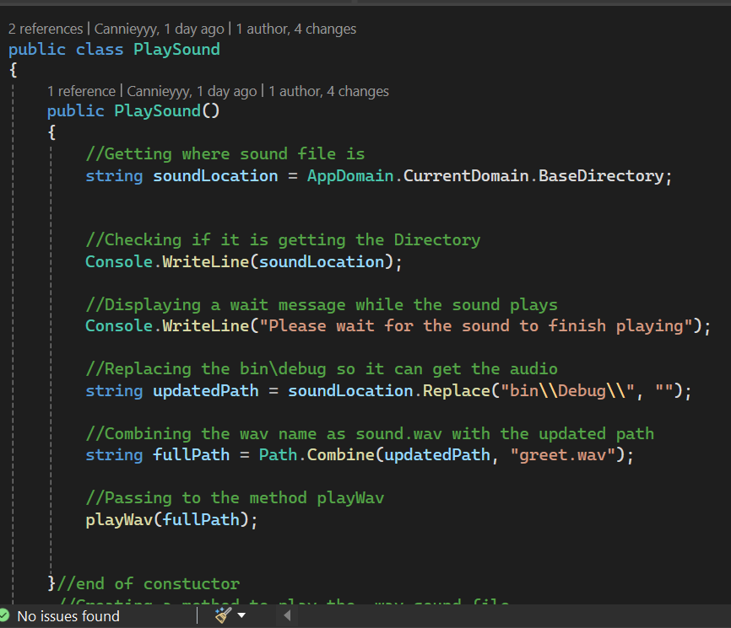
PlaySound class
The constructor
On the constructor:
The variable soundLocation:
Get’s the base directory.
Then we print the variable to see if it is getting the correct directory
The variable updatedPath:
Removes the bin\debug and replaces it with the project folder directory
The variable fullPath:
Combines the updatedPath with the file name
Then we invoke the method playWav to play the sound

Slide 8
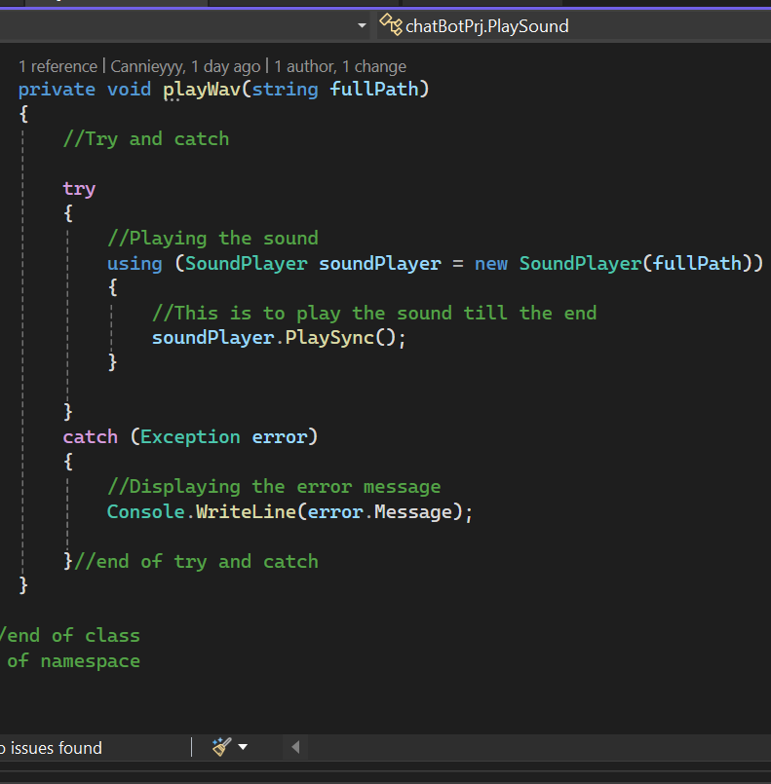
PlaySound class
The playWav method
The method playWav passes a String full path as a parameter
We have a try catch statement that’s going to handle the error if the file does not exist in the designated path. This helps to keep the program running even file is not available. Inside the try we have:
The SoundPlayer object to allow the sound to be played:
This object passes a string as a parameter, which is the fullPath we declared on the constructor
The method the plays the sound synchronically
The catch will display a error message

Slide 9
Class 3:
NAME: DisplayLogo Class(class that displays the logo)

Slide 10
DisplayLogo class
The code that allows the displays the picture/logo
On this class we are converting an actual image into an ascii-art and displaying it on the console program:
Load the picture and resize it
Use nested for loops to process the pixels
Convert the pixels brightness into asci characters
Display the picture on the console program

Slide 11
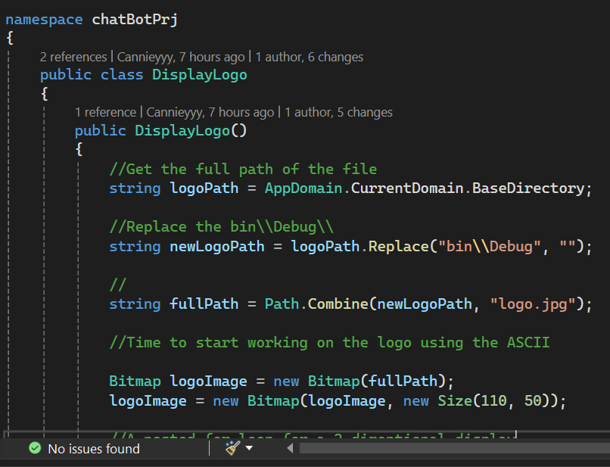
DisplayLogo class
The constructor
On the constructor:
The variable logoPath:
Get’s the base directory.
The variable newLogoPath:
Removes the bin\debug and replaces it with the project folder directory
The variable fullPath:
Combines the updatedPath with the file name
We use the BitMap object to draw the logo
This object passes a string fullPath as a parameter
Then we resize the image using its width and height

Slide 12
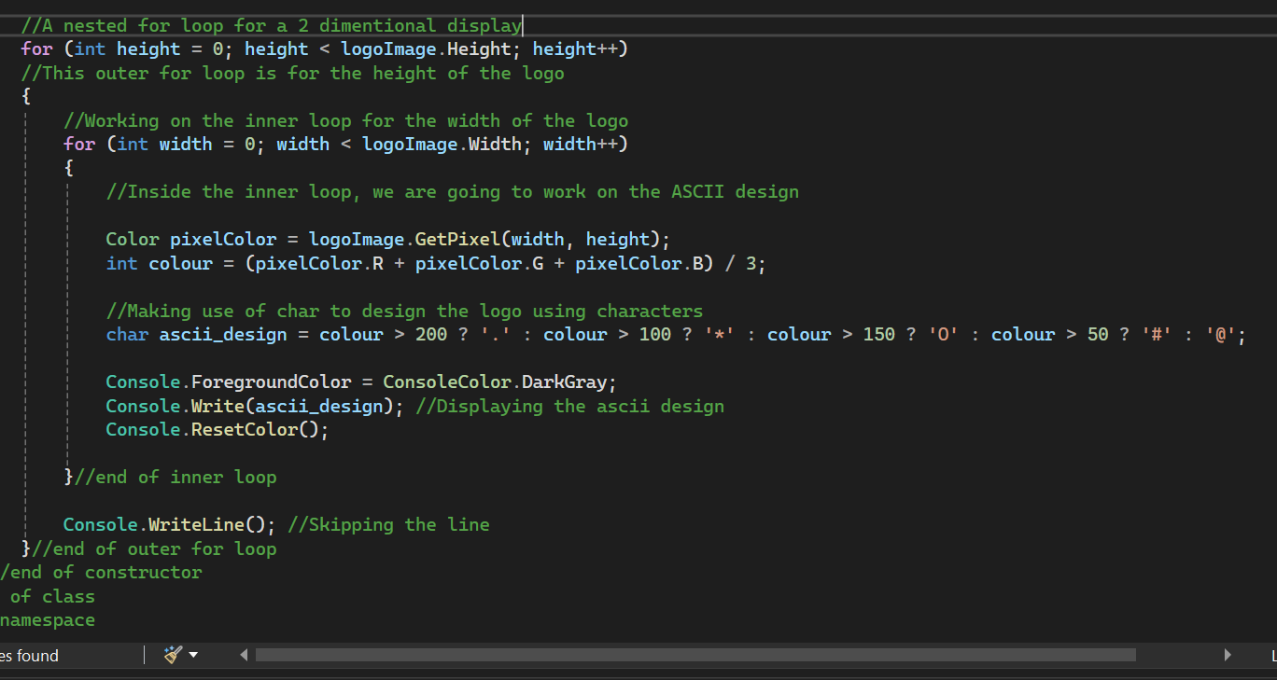
DisplayLogo class
The constructor
On the constructor (the loops):
The nested for loops allow us to print the picture in a two dimensional form, the loop is going to iterate until the entire picture have displayed:
The outer for loop works with the height of the picture
The inner loop works with the width of the picture and the design of the picture:
The variable pixelColor gets actual color of the picture
The color variable converts the pixelColor variable to the RGB scale

Slide 13
DisplayLogo class
The constructor
On the constructor (the loops):
The asci_design variable now formats the RGB colors into asci characters, shade of a color is assigned to a specific ascii_character
Now we display the asci_design variable to display the asci formatted picture
When we print the asci we don’t use Console.WriteLine because we don’t want every character to be displayed in a single line, instead we use WriteLine on the outer for loop to control it to display on each line only after the inner loop has iterated

Slide 14
Class 4:
NAME: ResponseCheck Class(class that lets the user interact with the program)

Slide 15
ResponseCheck class
The code that allows the user interact with the program
On this class we are letting the user ask questions to the the chatbot which serves as an cybersecurity assistant that educates the user about safety when using online platforms:
Welcomes the user and gets their name.
Allows the user to customize the bots name.
Loads predefined responses from a file.
Processes and answers user queries dynamically.
Displays responses with a realistic typing effect.
Handles input errors gracefully.
Keeps chatting until the user exits.

Slide 16
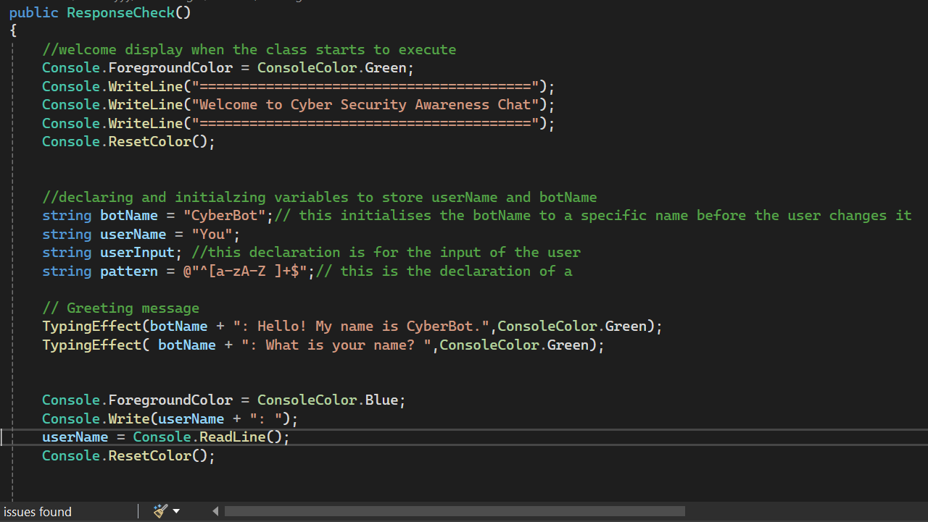
ResponseCheck class
The constructor
On the constructor:
When the program starts to execute:
A green welcome display will display
The bot’s response is green through out the entire program, unless the bot does not understand what the user is saying or if the user violates the restrictions of the chatbot – in this instance the colour is red instaed of green indicating that the correct response was not returned.
Then the bot will ask for the users name.
Then the user can enter their name into the given space.

Slide 17
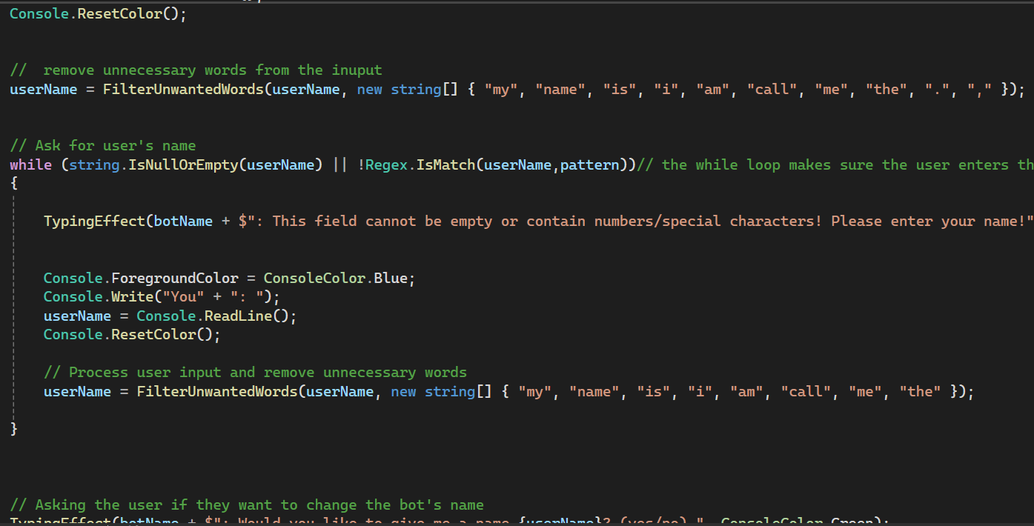
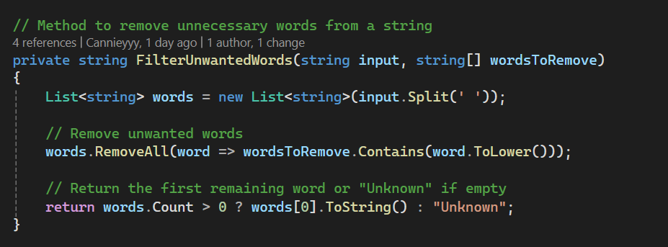
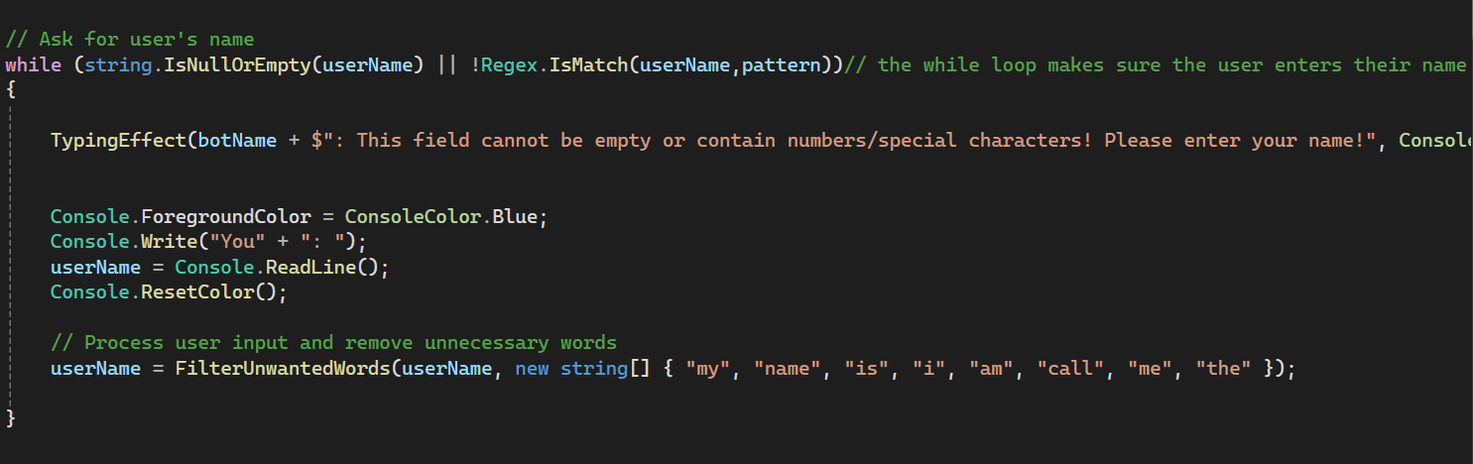
ResponseCheck class
The constructor
On the constructor (FilterUnwantedWords):
After the user has entered their name a the filterUnwantedWords will filter out all the unessecary words such as: “call me”, “my name is” and “I am” and only store the name
The while loop:
The while loop is for when the user does not enter anything into the designated space or types in numbers and characters, this does not allow the user to continue with the program until all conditions are met. Its going to keep asking the user to enter the name, the prompt will be red so that it indicates the user is violating the rules.

Slide 18
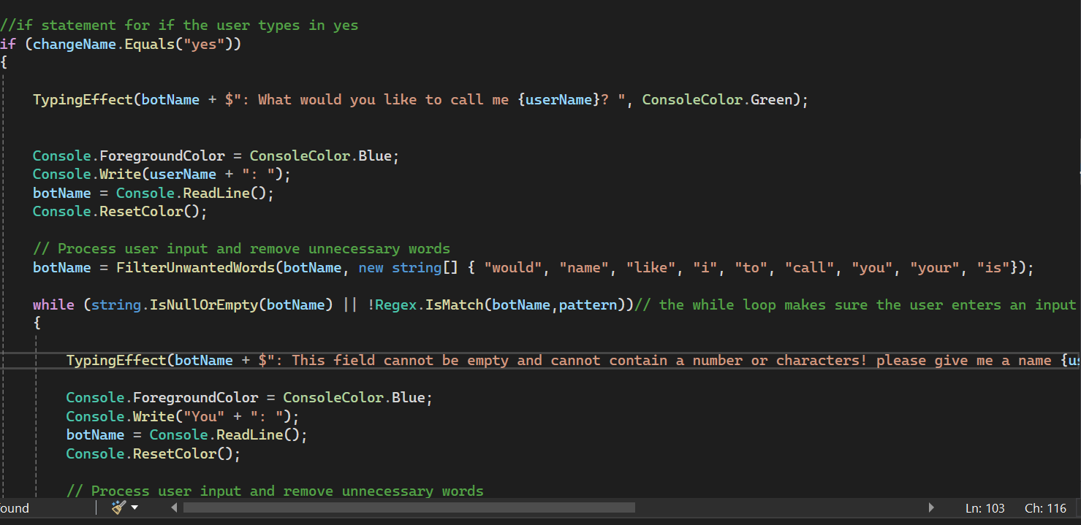
ResponseCheck class
The constructor(Bot Name Customization)
On the constructor (FilterUnwantedWords):
After the user name has been saved, the bot will ask the user is the want to create a name for the bot, if the user says yes the user will enter the name. Followed but filtering unnecessary words.
The while loop:
The while loop is for when the user does not enter anything into the designated space or types in numbers and characters, this does not allow the user to continue with the program until all conditions are met. Its going to keep asking the user to enter the name, the prompt will be red so that it indicates the user is violating the rules.

Slide 19

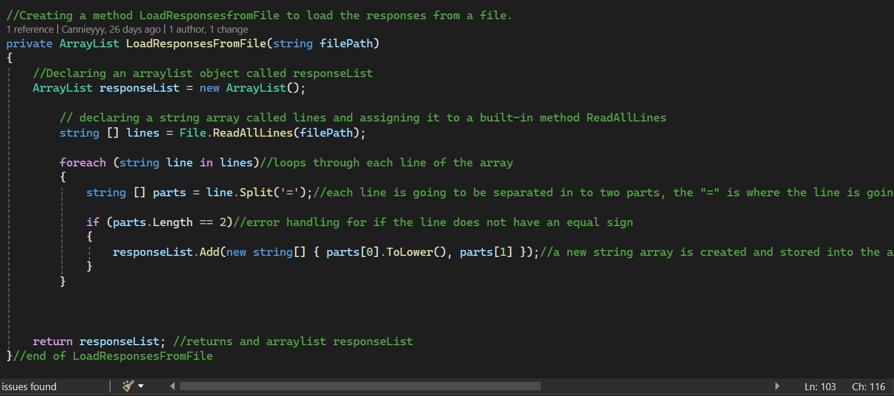
ResponseCheck class
The constructor(Load Responses)
On the constructor (LoadResponsesFromFile):
The chatBot will read the predefined responses from a text file (responses.txt)
We invoke the method LoadResponsesFromFile to the constructor to allow it to execute and then assign it to an array variable.
The method LoadResponsesFromFile reads all lines of the file and splits them into keyword and response using an equal sign (=) as a separator
After the lines have been split they will be stored inside the arrayList
…so if the userInput matches a keyword in the response list, its going to return a corresponding response.

Slide 20
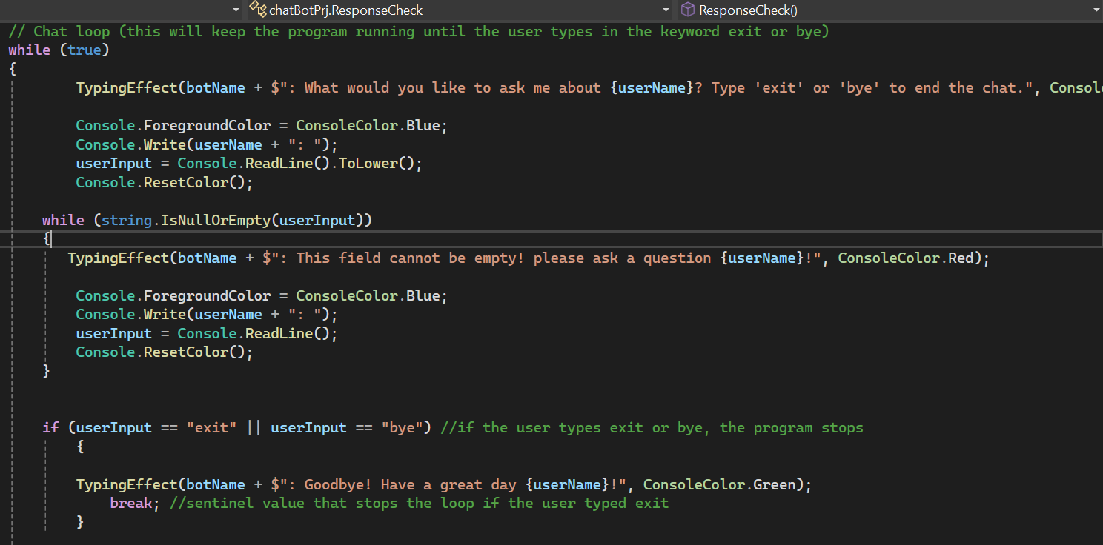
ResponseCheck class
The constructor(Continous While Loop)
On the constructor (chat loop):
A continuous while loop keeps asking the user for questions until they type “exit” or “bye”.
The chatbot processes the input:
Makes sure the user actually enters something (not blank).
Searches for matching keywords in responseList.
If a match is found, it displays the corresponding response.
If no match is found, a default response will display, suggesting topics the user can ask about.
Responses are displayed with a typing effect for a more interactive feel.

Slide 21
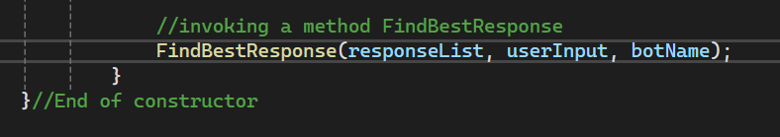
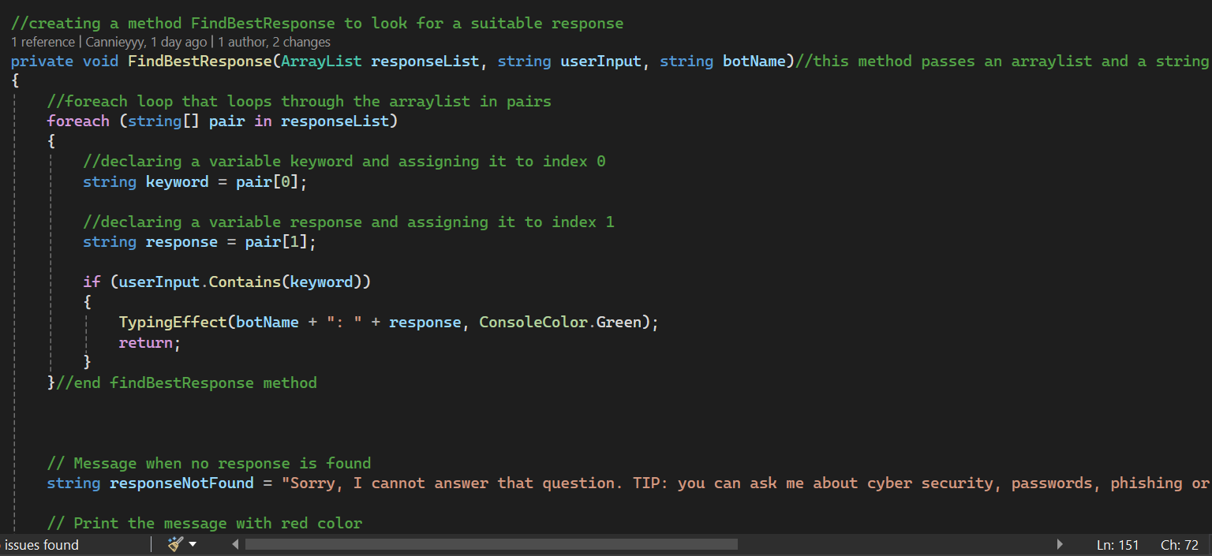
ResponseCheck class
FindBestResponse(Method)
This method loops through the reponse list to compare all the keywords with the user input:
First we invoke the method to the constructor.
This method passes the responseList, the userInput and the botName as parameters.
If a keyword is found, a corresponding response will return
Else a “notFound” message will display and the user will be guided as to what questions they can ask
This method is void hence it does not return any values or a value.

Slide 22
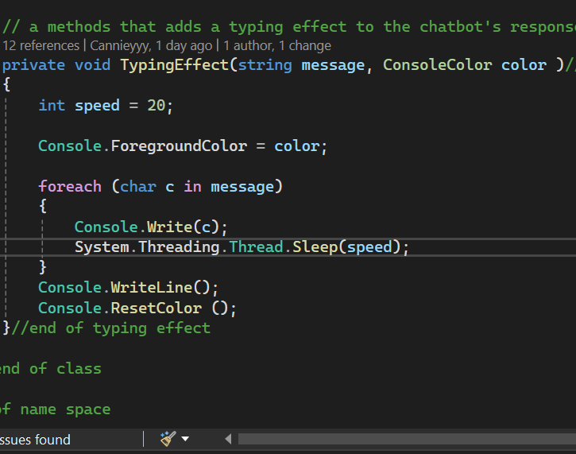
ResponseCheck class
TypingEffect(Method)
This method is supposed to make the user interaction seem real, as if the user is talking to another person:
We know that when we display a phrase in the program, every character displays all at once, so this method:
Delays the display of each character
Characters will display one at a time until all of them are fully displayed.
This Method takes the message and color as parameters
…and it does not return any value because it is void.

Slide 23

Errors Handled
Makes sure input is not empty before the program continues to run
Prevents user from adding numbers or special characters into the input
Handles missing files or files that are incorrectly formatted
Constant use of loops to avoid any unexpected behaviour

Slide 24


THANK YOU!
Kopano Leshope ST10459862
https://github.com/Cannieyyy/leshopeChatBotPrj

